Slide 1

Analysis of 2024 Election Data
Presented by: Madavan S
Mentorness Data Analyst Intern
Batch – MIP-DA-11

Slide 2

Introduction
Analyze the 2024 election data to gain insights into election results, party performance, and voter trends using Power BI, focusing on interactive visualizations and dashboards.
Combine election results with party alliance data to provide a comprehensive view of political dynamics across constituencies.
Perform detailed analyses, including overall results, state-wise and constituency-wise performance, and comparison of parties and alliances.
Create a user-friendly dashboard with filters and key performance indicators to explore and understand the election outcomes effectively.

Slide 3
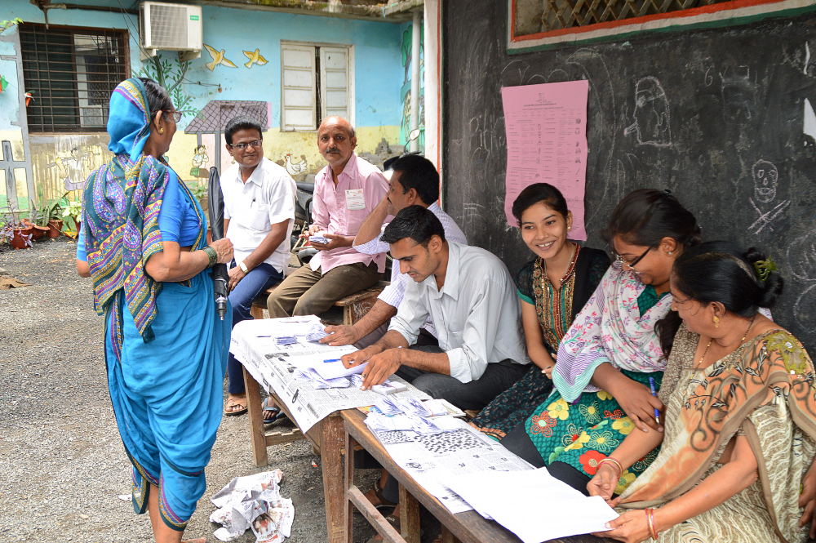
Problem Statement
Provide a detailed analysis of the 2024 election results, encompassing overall performance, state-wise, and constituency-wise dynamics.
Address the need to accurately combine and clean election results and party alliance data to ensure reliable insights.
Compare the performance of political parties and alliances, highlighting key metrics like seats won, vote margins, and election status.
Develop interactive dashboards to facilitate an in-depth exploration of election data, allowing stakeholders to filter and analyze results by various dimensions.

Slide 4
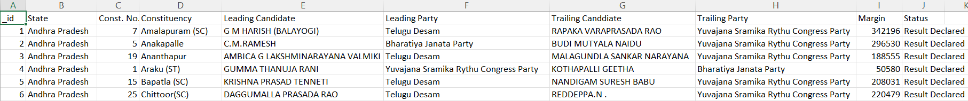
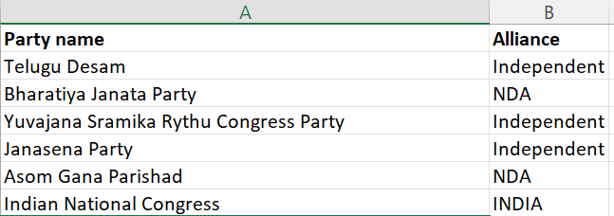
Dataset Description
1. Election Results Data:
- `_id`: Unique identifier for each record.
- `State`: Name of the state.
- `Const. No.`: Constituency number.
- `Constituency`: Name of the constituency.
- `Leading Candidate`: Name of the leading candidate.
- `Leading Party`: Name of the leading party.
- `Trailing Candidate`: Name of the trailing candidate.
- `Trailing Party`: Name of the trailing party.
- `Margin`: Vote margin between the leading and trailing candidates.
`Status`: Status of the election result.
2. Party Alliance Data:
- `Party Name`: Name of the political party.
- `Alliance Name`: Name of the political alliance the party belongs to.

Slide 5
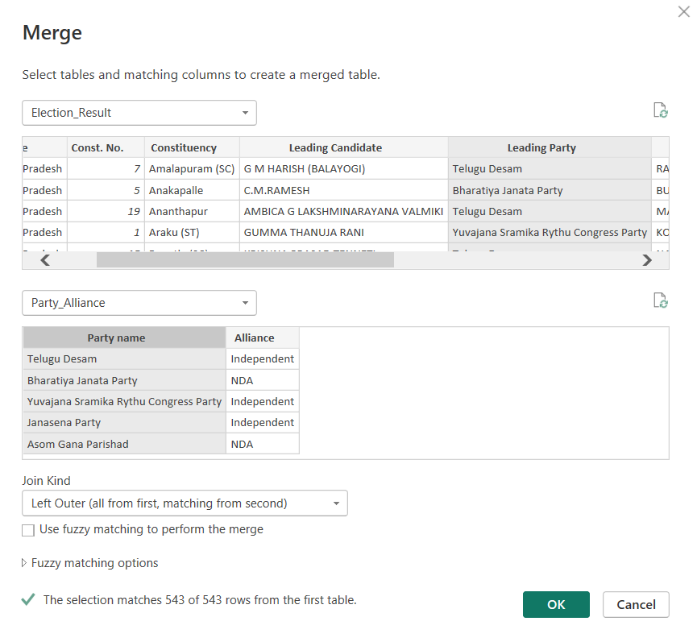
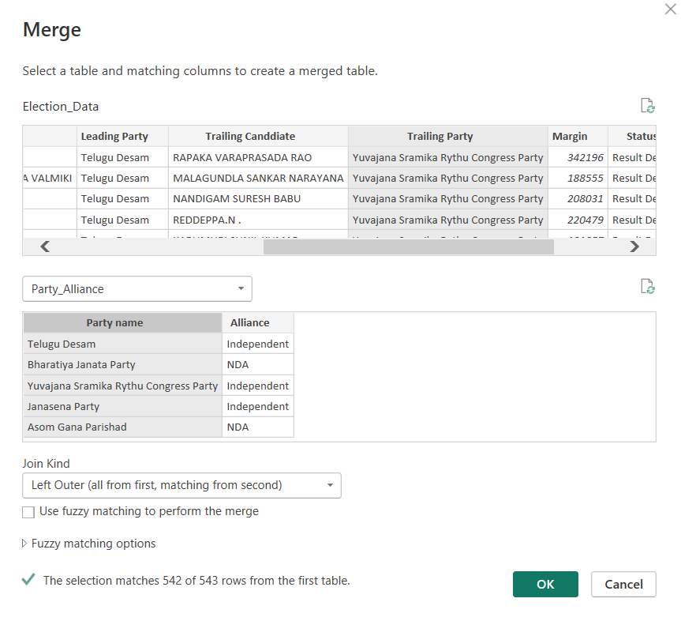
Data Processing in PowerQuery

Slide 6
Creating New Calculated Columns
% Margin = DIVIDE(Election_Data[Margin], SUM(Election_Data[Margin]))
Purpose: The `% Margin` column calculates the percentage of the vote margin relative to the total vote margin across all constituencies.
Formula Explanation:
- DIVIDE: A DAX function that performs division, handling divide-by-zero errors gracefully.
- Election_Data[Margin]: Represents the vote margin for each record in the `Election_Data` table.
- SUM(Election_Data[Margin]): Calculates the total vote margin across all records in the `Election_Data` table.
Calculation: Each constituency's margin is divided by the total margin, resulting in the percentage contribution of that constituency's margin to the overall total. This provides a normalized view of the margin, highlighting its relative significance.
Usage: Helps in understanding the impact of each constituency's vote margin within the larger context of the election results. Useful for comparing the relative performance of candidates across different constituencies.

Slide 7
Creating New Measures
Total Constituencies: Calculates the number of unique constituencies using DISTINCTCOUNT('Election_Data'[Const. No.]).
Total Votes: Sums the vote margins across all constituencies using SUM(Election_Data[Margin]).
Total Wins: Counts the number of rows where the election status is "Result Declared" using CALCULATE(COUNTROWS('Election_Data'), 'Election_Data'[Status] = "Result Declared").
Win Rate: Calculates the win rate by dividing the total wins by the total number of constituencies, defined as [Total Wins] / [Total Constituencies].

Slide 8


Slide 9
Results & Discussion
Dominant Party Analysis: The Bharatiya Janata Party (BJP) leads with the highest total votes and a significant number of wins, indicating its strong influence and widespread support across constituencies.
Alliance Performance: The NDA alliance has the highest number of overall wins, but the INDIA alliance outperforms in trailing positions, suggesting competitive dynamics between the alliances.
State-wise Insights: Visualizing the total wins by state highlights key battleground regions and showcases which states have higher political engagement and varied party representation.
Constituency-specific Trends: Detailed analysis of constituencies reveals hotspots with higher voter turnout and multiple wins, providing insights into local political landscapes and voter behavior patterns.

Slide 10
Future Scope
Enhanced Predictive Analytics: Incorporate machine learning models to predict future election outcomes based on historical data trends and voter demographics.
Real-time Data Integration: Develop capabilities to integrate and analyze real-time election data, allowing for dynamic updates and live tracking of election results.
Voter Sentiment Analysis: Use social media and public opinion data to analyze voter sentiment and its impact on election outcomes, providing deeper insights into electoral behavior.
Expanded Geographic Analysis: Extend the analysis to include more granular geographic levels, such as districts and wards, to capture a more detailed view of voting patterns and local political dynamics.

Slide 11
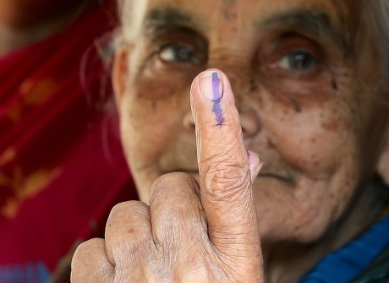
Conclusion
Data-Driven Insights: The analysis provides valuable insights into voter behavior and trends, enabling better understanding of election dynamics.
Visual Representation: The interactive dashboard enhances accessibility, making complex data easily interpretable for stakeholders and decision-makers.
Informed Decision-Making: Findings support strategic planning for future elections, guiding campaign efforts and resource allocation.
Foundation for Future Research: This project lays the groundwork for further studies, encouraging ongoing analysis of electoral data and evolving voter preferences.

Slide 12
Thank You

